Slide 1
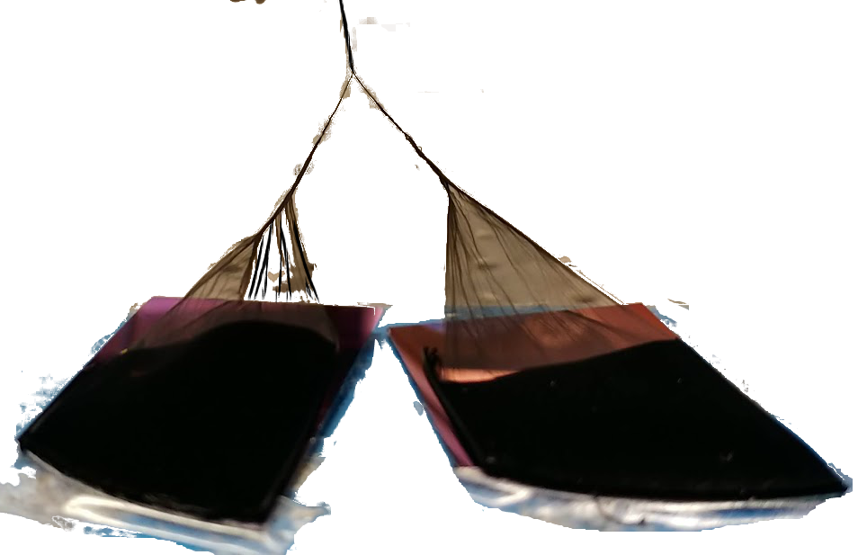
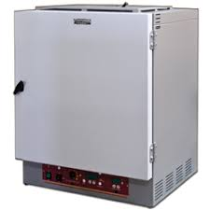
Battery Capacity and Use Megan Stafford Holmes High School, Algebra II
RET is funded by the National Science Foundation, grant # EEC-1710826
Summer Research
From Research to Classroom
Big Idea
Goals
Create a hybrid carbon nanotube (CNT) thread using sulfur-loaded CNT and a densified CNT to increase conductivity and tensile strength.
Use the hybrid thread as the cathode in the assembly of a lithium sulfur fiber battery.
Process
Planning & Organization
Optimizing battery capacity for all uses:
Research
Google Sheets
Google Drive
Google Classroom
Safari
Google
Challenge Based Learning
Fiber CNT Spinning
Engineering Design Process
CNT Array
Battery Health
Activity Monitor
System Information
Key Note
PowerPoint
Analysis & Evaluation
Presentation
He
O
Identify and Define
Gather Information
Identify Alternatives
2
Sulfur Melting Infiltration Synthesis
Things to Learn:
O₂ Plasma Functionalization
Refine
Communicate
Select Solutions
CNT + S
@ 155℃
Utilize applications to assist with data collection
Interpret trends and graphical behavior
Communicate Solution
Evaluate Solution
Implement Solution
Battery Assembly

